Slide 1
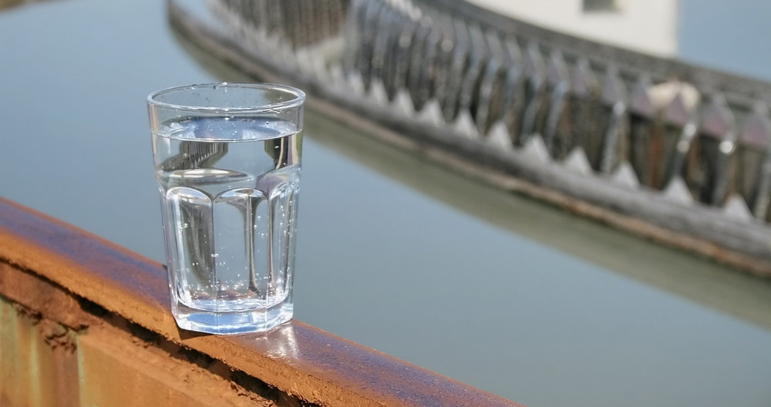
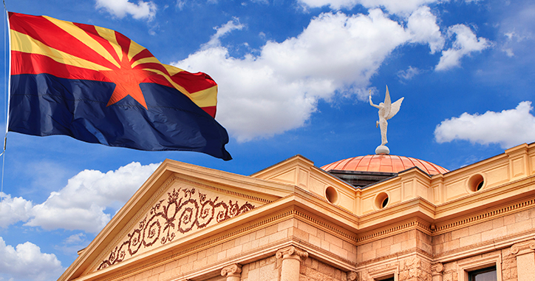
Industrial Wastewater Treatment Technologies
Dr. Jake Davis
Intel Ocotillo Infrastructure Engineer
Arizona Environmental Strategic Alliance Oct 2019
Notes:
Introductions
The importance of water isn’t well understood by the general public, I read recently and I thought it was well stated, the most people living in the Phoenix metro area didn’t realize that we are in a 19 year drought simple b/c they are able to turn the fawcet and water comes out. More importantly, they don’t know were it comes from and what is necessary to keep the supply of fresh clean water available.
According to the World Water Council, 1.1 billion people did not have access to clean drinking water in 2018
We are here today to discuss elements of a water management strategy that have enabled Intel’s manufacturing growth in the desert while helping our community
Agenda
These elements include
First acknowledging the global and local challenges facing our community
Water shortage
TDS
Developing a partnership with our local municipality
working together to address the communities challenges in creative ways
supporting the differing objectives of our organizations
We will give some examples of where we have been successful working with the city
We will talk to what we are going to do in the future

Slide 2
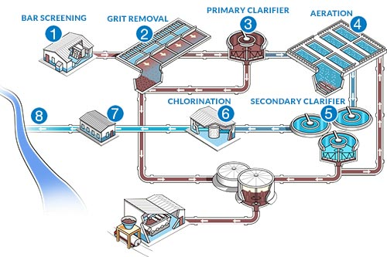
Wastewater treatment
Wastewater treatment is a process used to remove contaminants from wastewater or sewage and convert it into an effluent that can be returned to the water cycle with minimum impact on the environment, or directly reused
TN
COD
TSS
CECs
TDS
NH₄⁺
NO_{x}⁻
P
Notes:
The typical way people think about wastewater treatment.
Municipal wastewater treatment plants are very effective at treating the compounds in green.
Refined medical knowledge, and better analytical techniques have brought CECs front and center in our conversations about wastewater treatment
CECs are contaminants of emerging concern: Pharmaceuticals and personal care products (PPCP),endocrine disruptors, disinfection byproducts…
TDS – total dissolved solids – is a topic that is only particularly relevant in arid climates, and constitutes a particularly expensive problem to address

Slide 3
Notes:
This is a look at how most Industrial Wastewater treatment systems are set up:
These systems tend to avoid feedback loops
Wastes of a specific type tend to be combined and sent to a specific treatment system
The goal truly is to maintain compliance with the local regulatory bodies

Slide 4
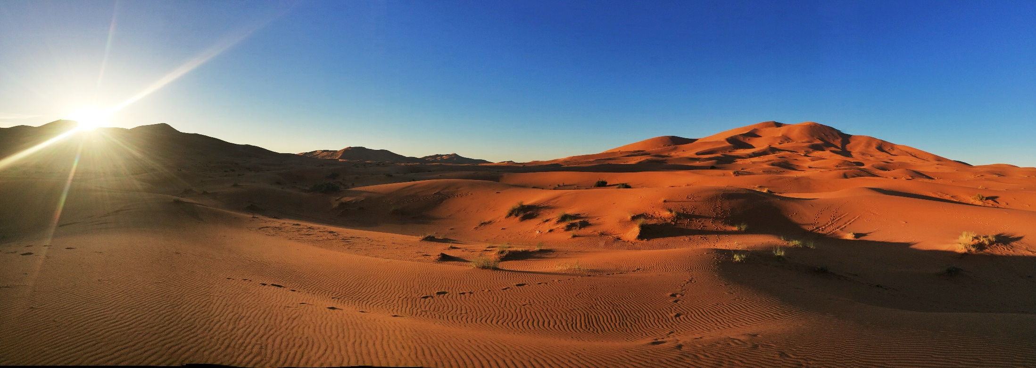
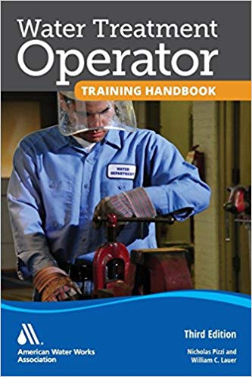
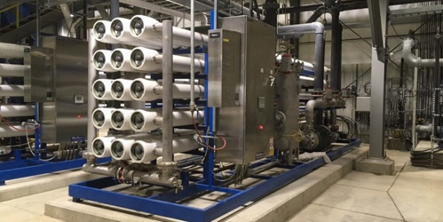
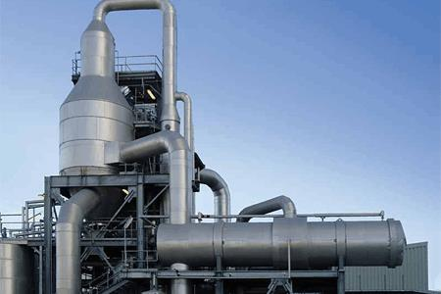
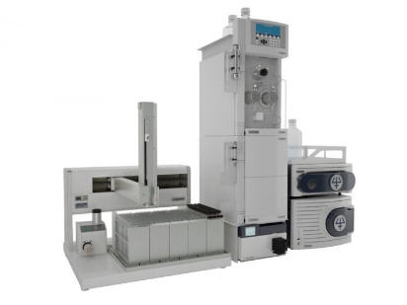
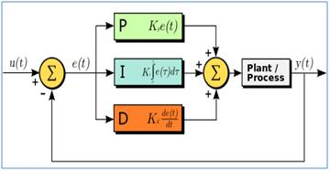
The future of wastewater treatment in arid climates will center on technologies that enable reuse
Refine existing reclaim technologies, and develop new more cost effective technologies
Develop more robust online analytical systems
Increase the use of advanced control systems
Adjust operator training

Slide 5
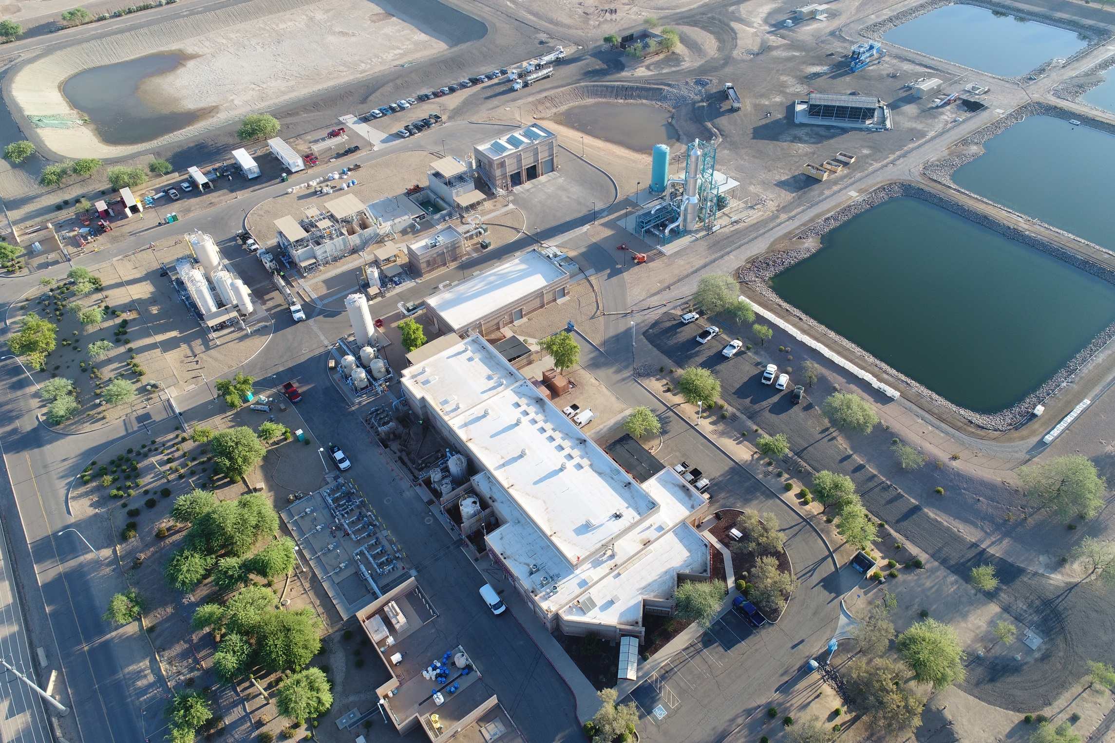
The Ocotillo Brine Reduction Facility (OBRF)
Notes:
The Ocotillo Brine Reduction Facility (OBRF) is a solid example of intel working with the City of Chandler to address our communities water and wastewater challenges
owned City of Chandler, but subsidized by Intel Ocotillo.
The OBRF receives all of intel ocotillo’s TDS laden 1st pass RO reject an
prevents (approx. 22 ton/day) of salt from being discharged into our environment
Tech note CLS, MMF, IX, high pH RO, BC to
recover more than 94%
2.8 Mgd, currently 1.5 Mgd of 50 ppm TDS water.
In its 25+ year history this facility has effectively offset over 16.5 billon gallons of potable water withdrawals
Primarily serves to TDS out of our water supplies – all salt ends in ponds
The water it recovers is a bonus
Stress TDS is not a regulated constituent, and Intel CoC do this because it is right
gold standard for a public/private partnerships

Slide 6
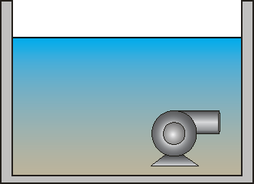
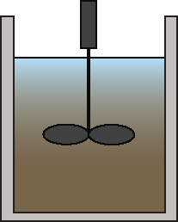
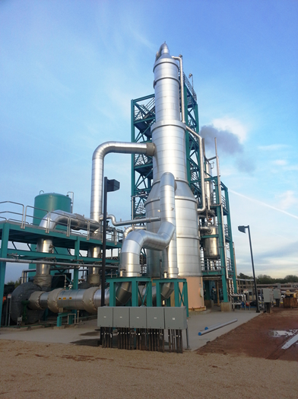
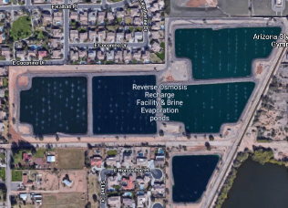
The OBRF
Influent Pump Station
Rapid Mix
Reactor
Clarifier
Filters
Break Tanks
Intel RO Reject
Thickened Sludge Storage
Belt-filter Press
Dewatering
Ion Exchange
RO
Cartridge Filters
RO Permeate for Reuse
Thermal
Brine Concentrator
Brine Evaporation Ponds
Notes:
The Ocotillo Brine Reduction Facility (OBRF) is a solid example of intel working with the City of Chandler to address our communities water and wastewater challenges
owned City of Chandler, but subsidized by Intel Ocotillo.
The OBRF receives all of intel ocotillo’s TDS laden 1st pass RO reject an
prevents (approx. 22 ton/day) of salt from being discharged into our environment
Tech note CLS, MMF, IX, high pH RO, BC to
recover more than 94%
2.8 Mgd, currently 1.5 Mgd of 50 ppm TDS water.
In its 25+ year history this facility has effectively offset over 16.5 billon gallons of potable water withdrawals
Primarily serves to TDS out of our water supplies – all salt ends in ponds
The water it recovers is a bonus
Stress TDS is not a regulated constituent, and Intel CoC do this because it is right
gold standard for a public/private partnerships

Slide 7
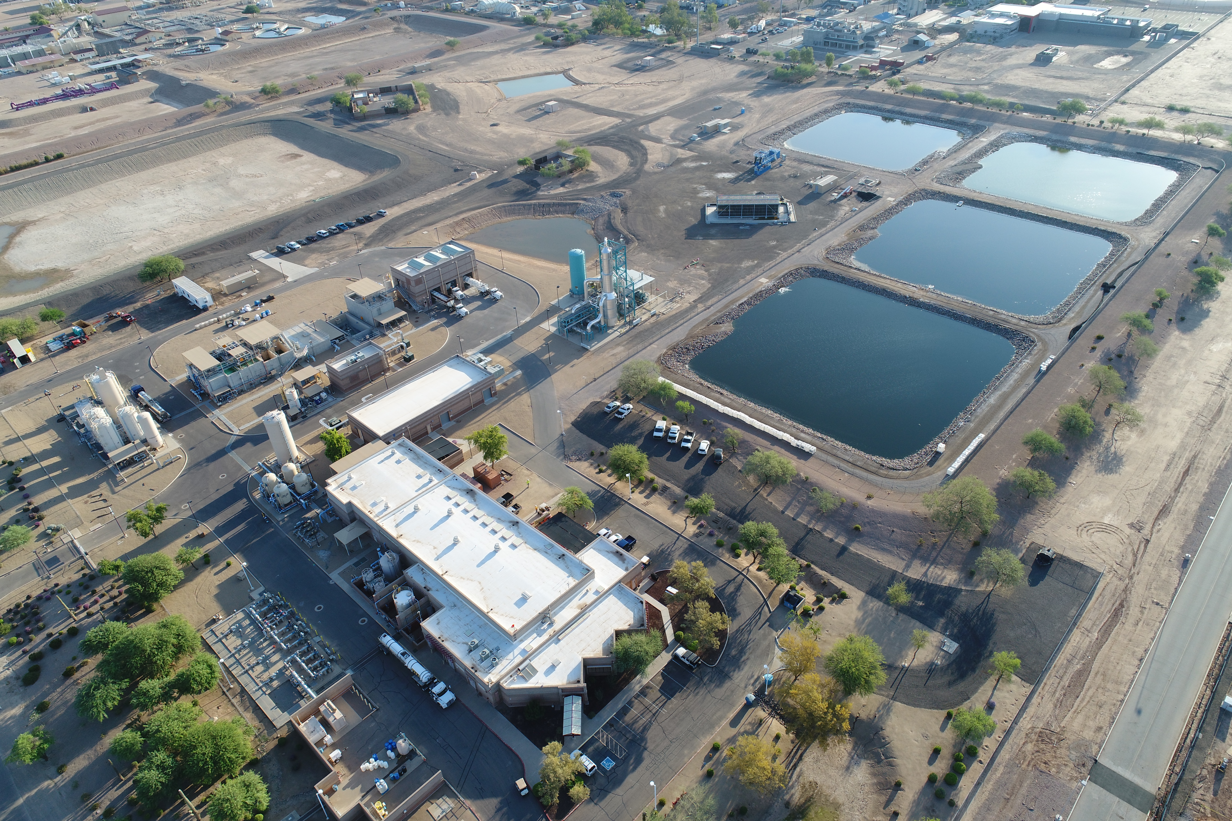
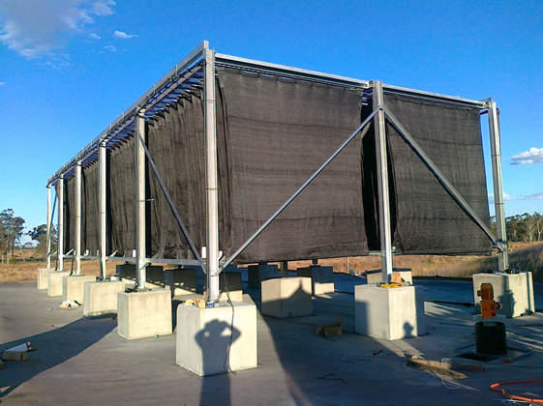
Alternative
Brine Management
Notes:
Our efforts to subsidize pilot scale testing of alternative brine management strategies also demonstrates Intel’s edict of putting our community first
Brine management is clearly one of the most challenging obstacles facing out community
We are at the bottom of the Colorado, and are most significantly impacted by the TDS feedback loop
The tech here is essentially a green brine concentrator
It addresses the other major issue associated with energy hungry inland brine management options
It addresses the foot print barriers associated with brine ponds by artificially increasing ft2/ft2 (40), and leveraging better mass transfer out of the boundary layer
Better than a pond by 15 to 20 times
This particular technology worked but was not mature enough for industrial applications
We will continue to work together to develop the technologies our community needs
Check Name of WAIV

Slide 9
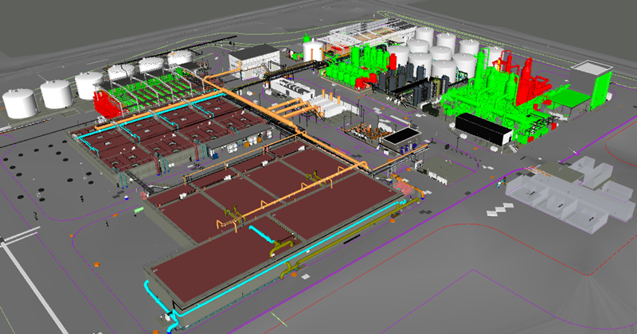
The Next Generation IWW Treatment Facility
Notes:
We are going to talk about:
Active 2020
About 12 acres, roughly doubles the number of Intel Ocotillo waste system assets, and clearly demonstrates our commitment to the future
Facility employs thermal concentration and crystallization technology capable preventing a significant amount of TDS from entering the local water sheds
Enables intel to supply water to internal loads (i.e., CT, and non-process loads)
Ensures environmental compliance for the foreseeable future, and helps intel meet corporate environmental 2025 goals
This facility is so substantial that it can even improve the quality of our communities reclaimed water supplies
It can have a first order impact on the city’s municipal infrastructure needs as our community grows

Slide 10
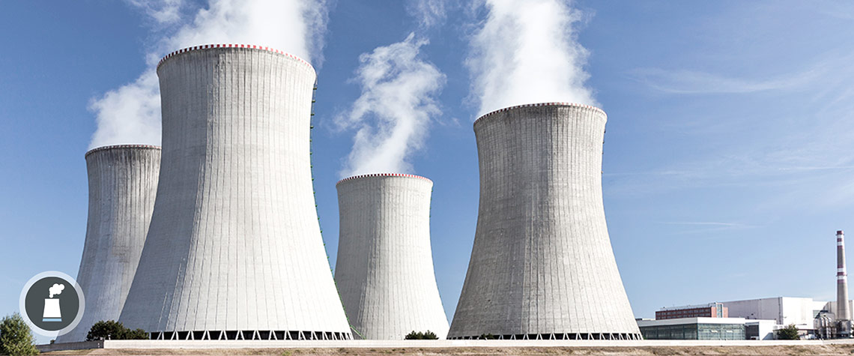
Industry in arid climates will begin to assess wastewater treatment efficiency in a new way
$$η=\frac{Q_{Evap}}{Q_{Demand}}$$
$$ΔS_{sys}=\frac{Q}{T}>0 ∀ irreversible processes$$

Slide 11
Our community supports Intel, and Intel supports our community

Slide 12
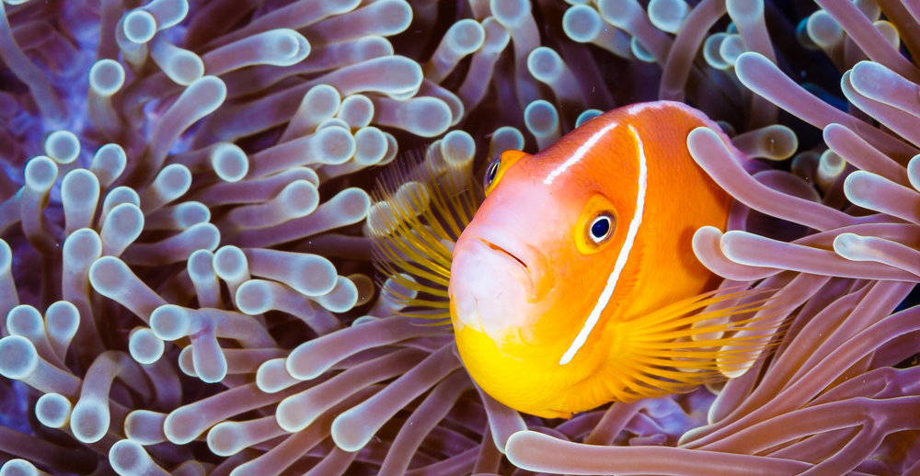
Mutual Benefits
Notes:
Intel and COC have engaged since the 1990’s in a mutually beneficial partnership that has yield a variety of results including the OBFR, coordinated infrastructure expansions for both water supply and industrial waste water. This relationship continues to be the cornerstone of the Ocotillo site’s water and waste water management strategy that provides for:
Enabling Intel’s manufacturing growth in AZ
Providing a conduit for helping to meet Intel’s 2025 environmental water goals
Reducing the stress on the municipalities infrastructure as is enables population and industry growth in Chandler

Slide 13
Questions?

